Slide 1
Azure machine learning meetup
Coding a convolutional neural net (CNN) using CNTK
(Microsoft’s cognitive Toolkit)
August 17, 2017

Slide 2
agenda
Quick recap from last session – Concepts for CNN
Review code and structure of a working CNN (existing tutorial)
Decompose and modify
Examine impact, changes, mistakes
Debugging, tracing
Summary

Slide 3
Recap from July 29
Key concepts:
Convolution
Filter (feature) maps
Convolutional layers
MaxPooling
Minibatch
Learners and their parameters

Slide 4
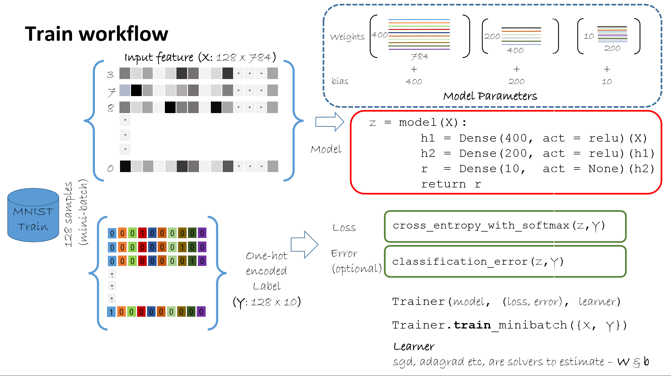

Slide 5
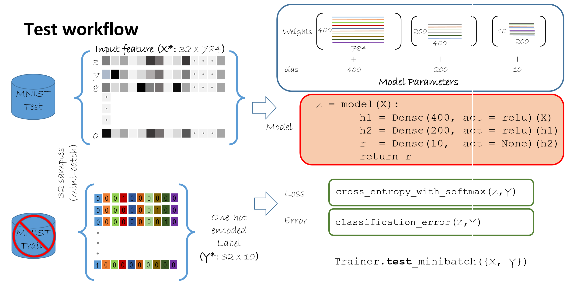
testing

Slide 6
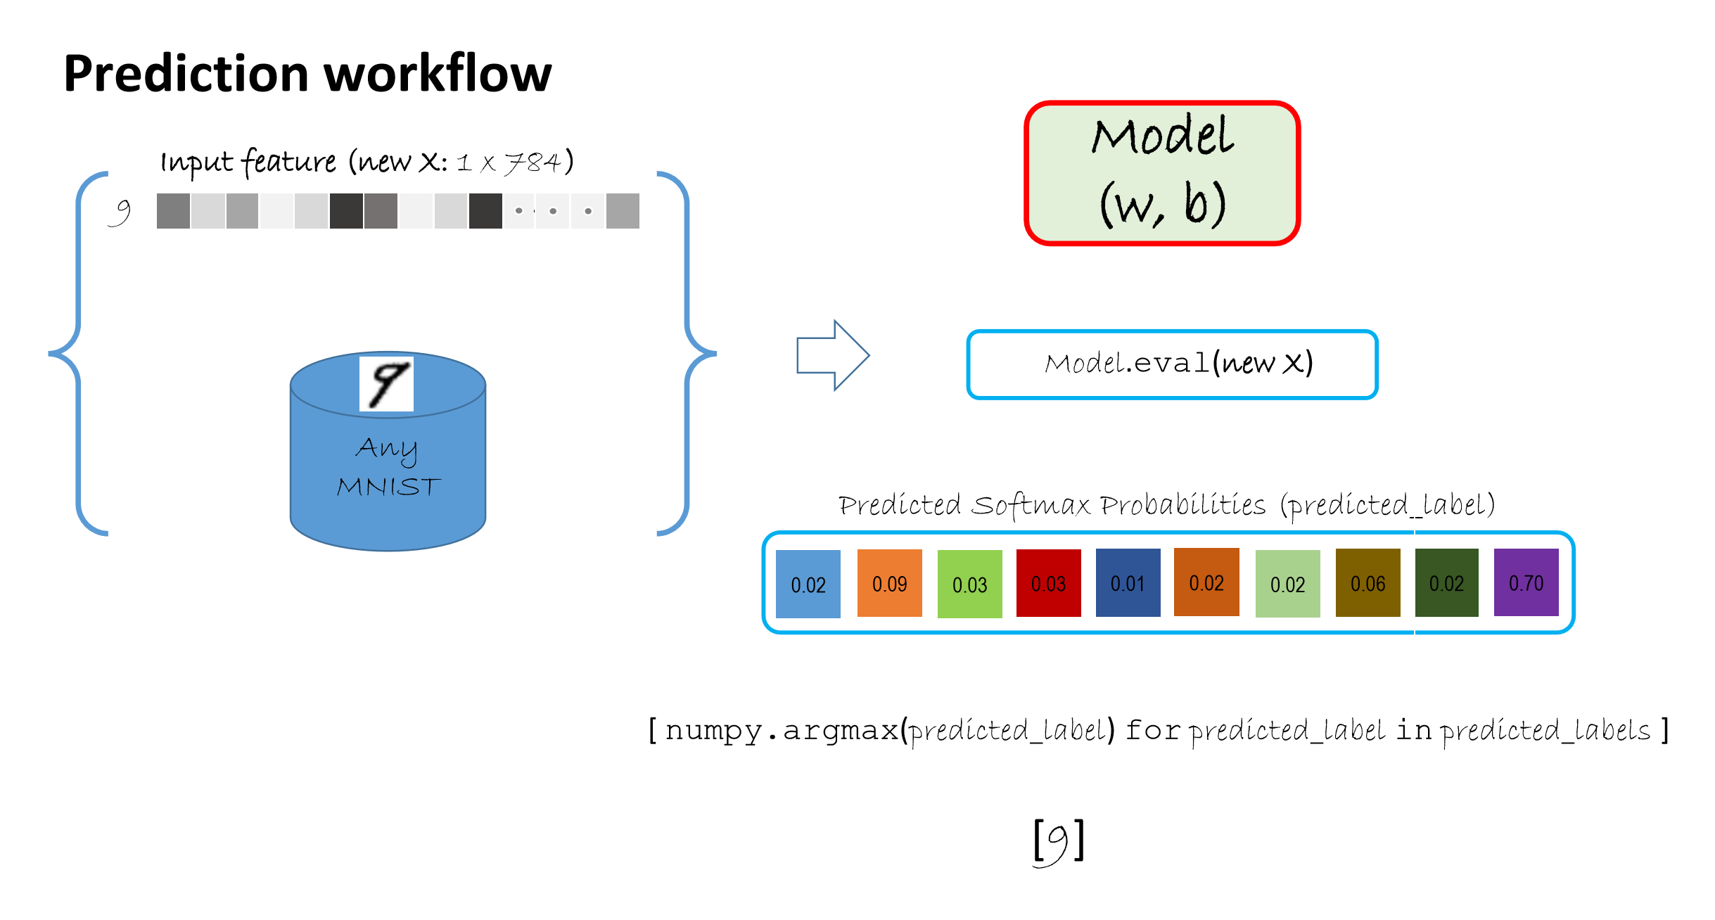

Slide 7

recall
Code builds and binds these classes together
Trainer
Data, Shape, Features
Learning rate (SGD, Adam..)and parameters
Model (network)
classification error,activations
Learner
Batch size, epochs, loggers
output

Slide 8
Session code – backgrounder
CNTK exposes APIs for Python, Java, C++, (and C# - relatively new)
The CNTK Programming Model: Networks are Function Objects…supporting a wide range of neural networking architectures
CNTK function objects are not backed by numpy arrays. Rather, they are represented internally as graph structures in C++ that encode the computation, similar to other deep learning toolkits. In fact the line
d = Dense(5, np.tanh) # is just constructing a graph, while the line
y = d(np.array([1, 2])) # is feeding data to the graph execution engine.

Slide 9
Two key concepts
Printing a CNTK function will give you an output similar to the following format:
Operation(Sequence[Tensor[shape]], other arguments) -> Tensor[shape]
The CNTK graph structure is wrapped in the Python class Function that exposes the necessary interface so that other Python functions can call it and access its members - such as W(eight) and b(ias).

Slide 10
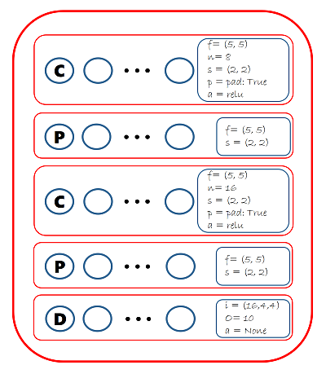
Our starter network using Graph API calls
with C.layers.default_options(init = C.layers.glorot_uniform(), activation = C.relu):
h = features
h = C.layers.Convolution2D(filter_shape=(5,5),
num_filters=8, strides=(1,1),
pad=True, name="first_conv") (h)
h = C.layers.MaxPooling(filter_shape=(2,2),
strides=(2,2), name="first_max") (h)
h = C.layers.Convolution2D(filter_shape=(5,5),
num_filters=16, strides=(1,1),
pad=True, name="second_conv") (h)
h = C.layers.MaxPooling(filter_shape=(3,3),
strides=(3,3), name="second_max") (h)
r = C.layers.Dense(num_output_classes,
activation = None, name="classify") (h)
return r

Slide 11
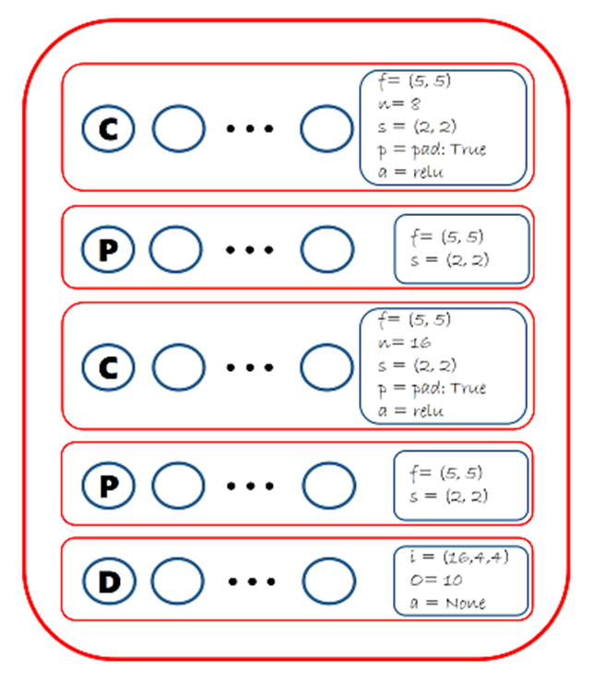
The Functional Way – how is It different?
def create_model_mn_factory():
with cntk.layers.default_options(activation=cntk.ops.relu, pad=False):
return cntk.layers.Sequential([
cntk.layers.Convolution2D((5,5), num_filters=8, strides=(2,2), pad=True), # reduction_rank=0 for B&W images
cntk.layers.MaxPooling((5,5), strides=(2,2)),
cntk.layers.Convolution2D((5,5), num_filters=16),
cntk.layers.MaxPooling((5,5), strides=(2,2)),
cntk.layers.Dense(num_classes_mn, activation=None)
# no activation in final layer (softmax is done in criterion)
])#end Sequential Layering
model_mn = create_model_mn_factory()

Slide 12
Last pre-code/demo slide
Using Python for a few reasons:
Two levels exposed – a low level (graph based) and high level (functional) view – this is the steepest part of learning the API
CNTK supports Keras which offers x-framework capability (Tensorflow…)
Richest (if still evolving) set of docs and examples
Key takeaway:
Python CNTK elements are just wrappers over C++ implemented tensors, math routines, and other data structures.
Creating Python CNTK elements is different than binding them – it’s a common error
Using the “layers library” is easier, safer, and more readable and you can mix and match
Let’s look at the code

Slide 13
Guidelines summary
Use the layers library as much as possible
If you have a GPU make sure CNTK ‘sees’ it: print(cntk.all_devices() )
Understand CNTK's types and assumptions.
The Python API documentation tries to include examples of usage for every basic operation so it is easy to see for each operation what is expected and what gets produced.
When debugging, print or (repr) each function to verify the types of its inputs and outputs.
Verify weight sharing and other structural issues in your network by plotting the underlying graph
There is an integrated terminal (tty) based type of debugger – it is very verbose and do not enable it unless you are sure you have an integrated terminal – debugging.debug_model(your model)
Use set_checked_mode(True) to figure out which operation is producing NaNs
Use debug_model(function) and set_computation_network_trace_level(level) to smoke out any remaining bugs.
For reproducing results/problems: cntk.set_fixed_random_seed(value)
If using the graph API level make sure you bind correctly:
combined = C.layers.Dense(64, activation=C.sigmoid)(combined) #this is correct
combined = C.layers.LayerNormalization() #no error but this won’t bind and creates placeholder only

Slide 14
Debugging (interactive)
In your code you first wrap your model in a CNTK debug wrapper
netout = Sequential([For(range(num_hidden_layers), lambda i: Dense(hidden_layers_dim, activation=sigmoid)),Dense(num_output_classes)])(feature)
netout = C.debugging.debug_model(netout) #wrapped 8/11
When you run this you will get an interactive prompt (command line) and a small set of commands to use (print, next node, jump ‘n’ nodes, …)
Documented at:
https://docs.microsoft.com/en-us/python/api/cntk.debugging.debug?view=cntk-py-2.0
You can also jump into pdb
>>>d
If you cannot get input working then the input is looking elsewhere (wrong shell, etc)

Slide 15
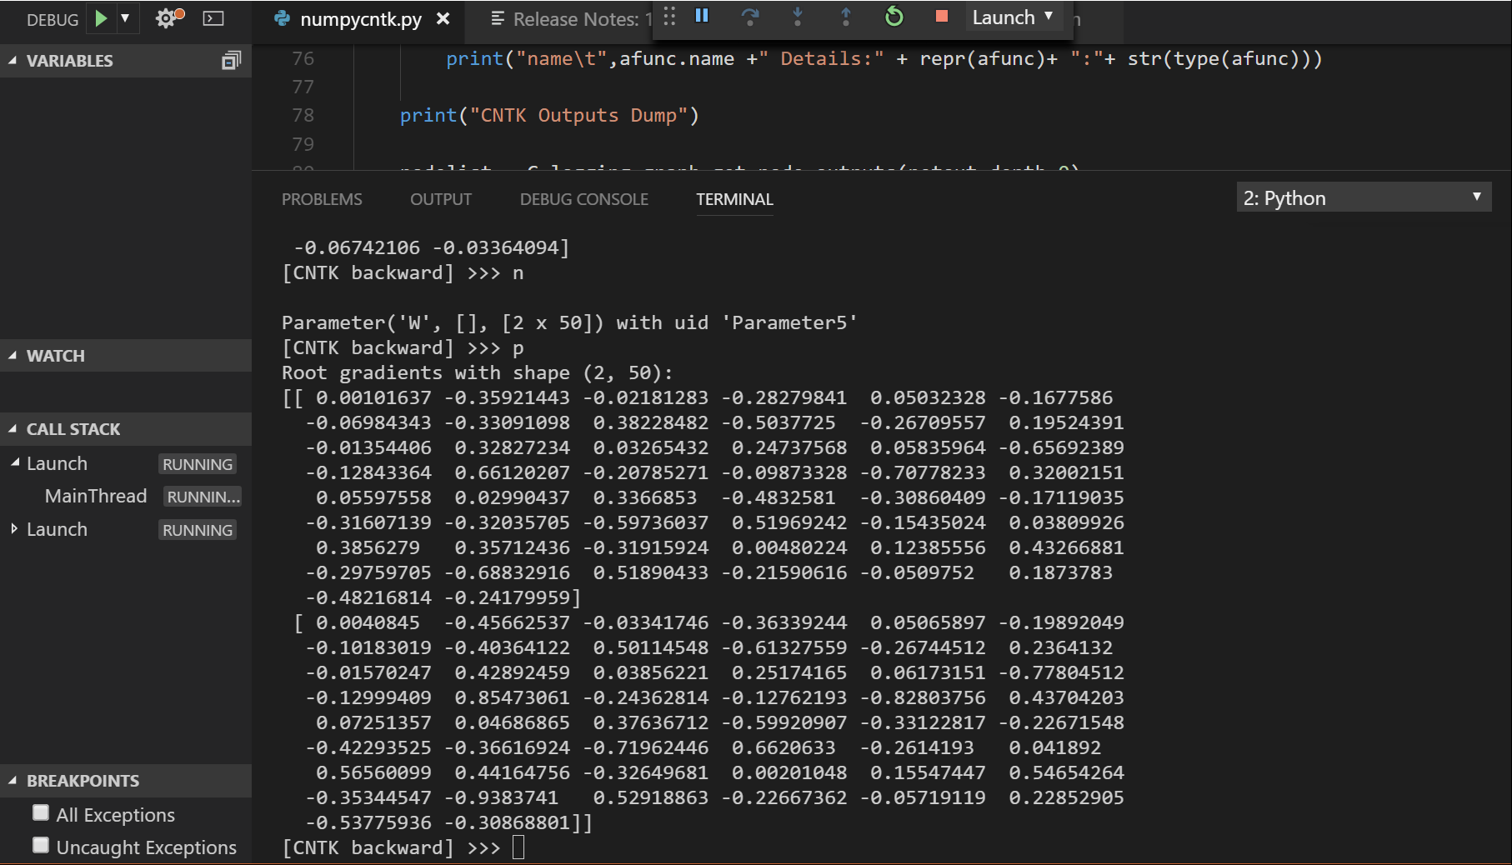
VS CoDe – interactive window with CNTK debugging enabled

Slide 16


Slide 17
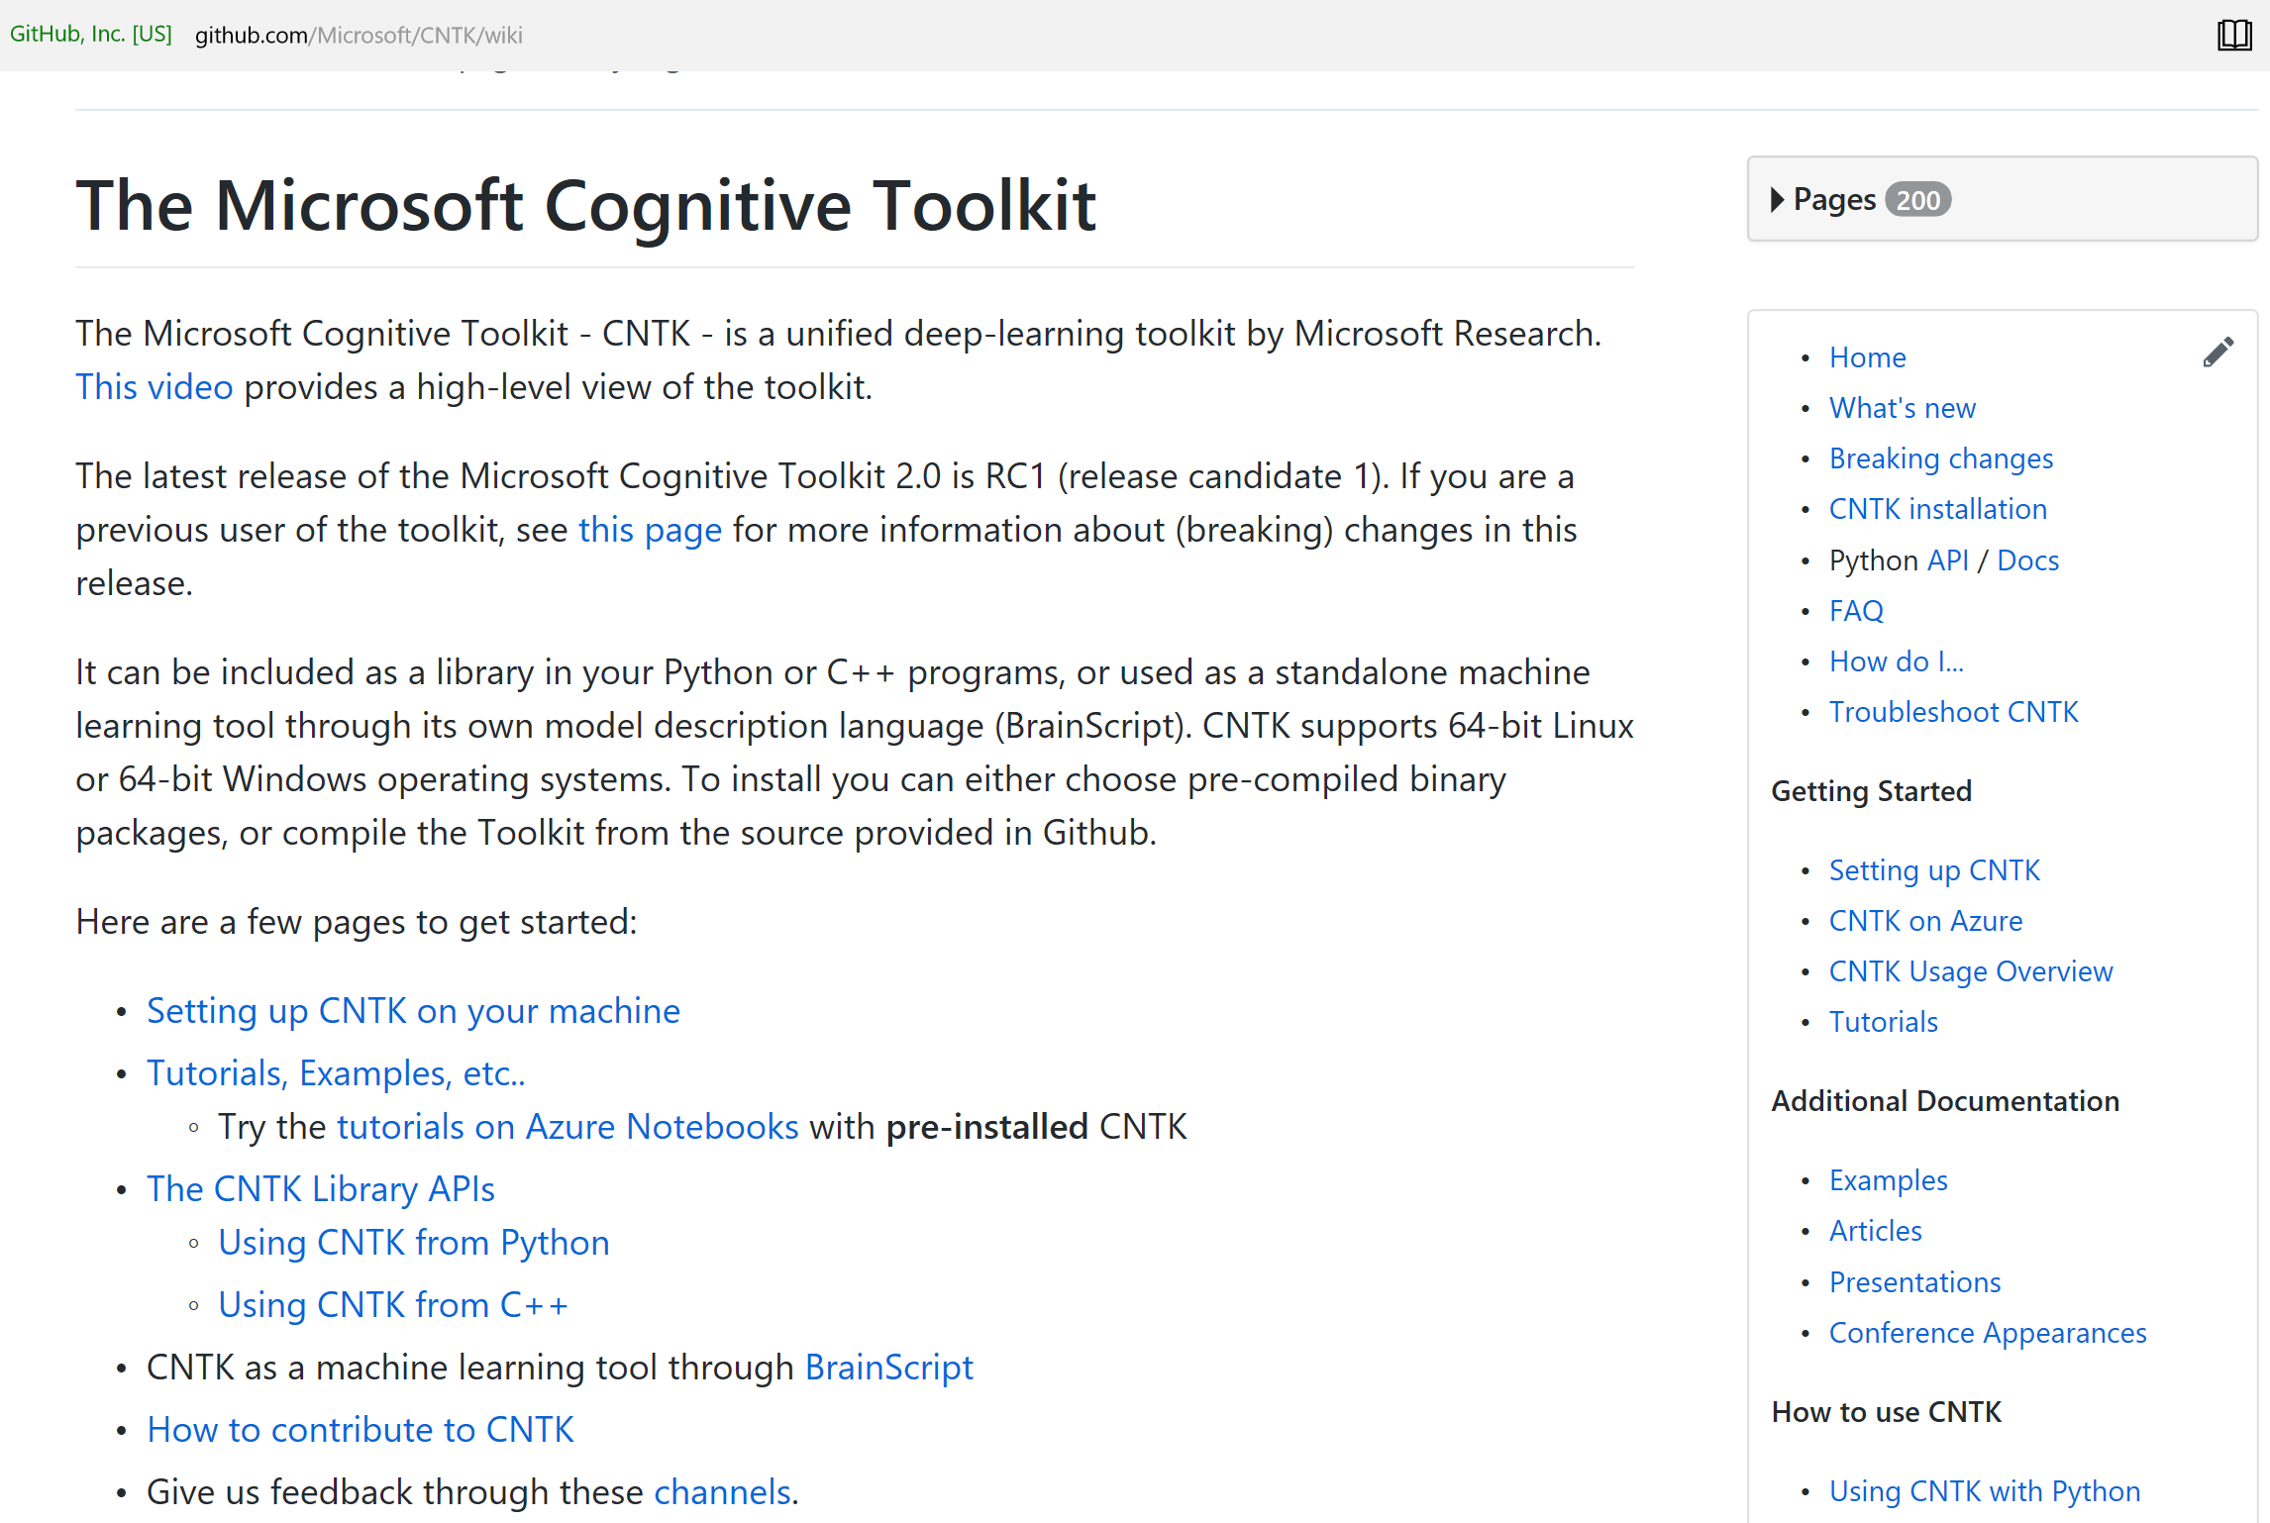
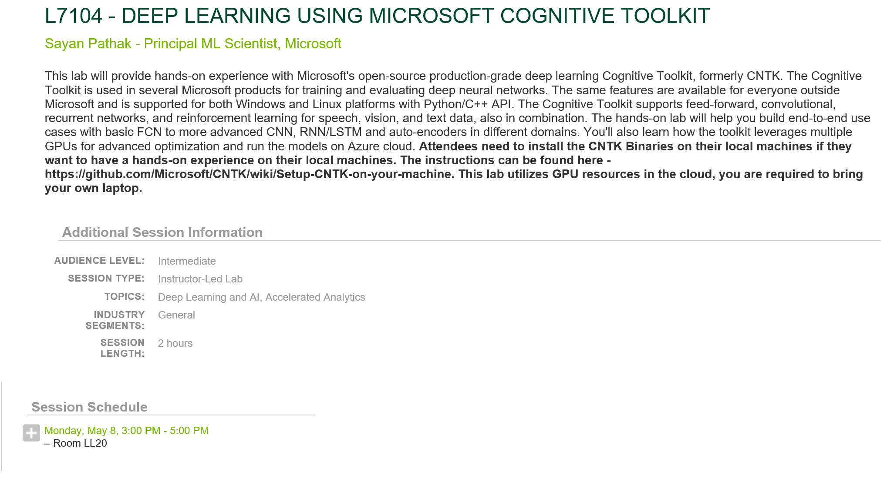
Where to begin? V2.1 is now available
On GitHub: https://github.com/Microsoft/CNTK/wiki
Tutorials:
https://www.cntk.ai/pythondocs/tutorials.html (latest release)
https://github.com/Microsoft/CNTK/tree/master/Tutorials (latest)
Azure Notebooks: Try for free pre-hosted
https://notebooks.azure.com/cntk/libraries/tutorials
Seek help on Stack Overflow:
http://stackoverflow.com/search?q=cntk (please add cntk tag)
Seek help on Stack Overflow:
http://stackoverflow.com/search?q=cntk (please add cntk tag)

Slide 18
thanks
https://www.meetup.com/New-York-Azure-Machine-Learning-Meetup/
https://github.com/­jimwill3/NY-AZML-Me­etup
survey
Next meetup aiming for September 28, 2017

